Slide 1

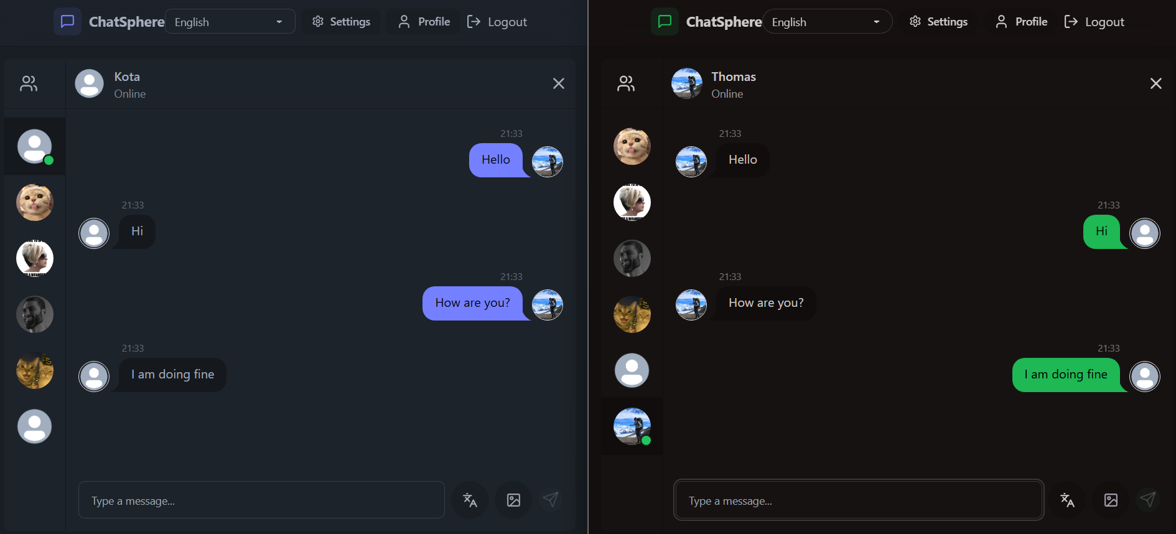
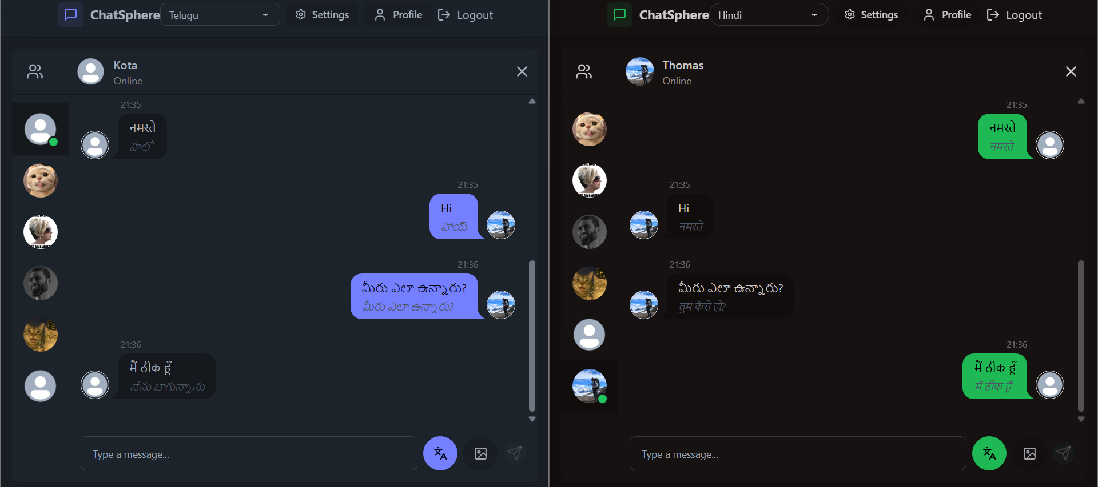
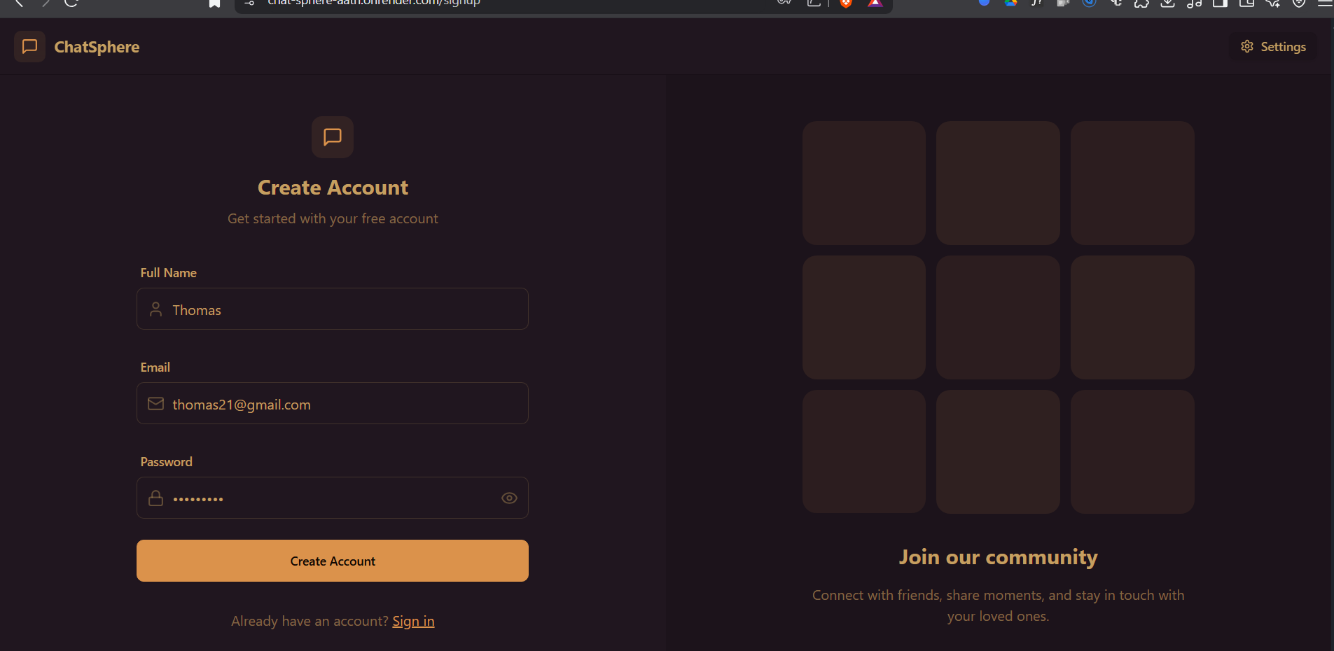
ChatSphere: Chat App with Translation
Mentor: Dr. Reddy Sekhar K
Assistant professor (Sr.)
Abdul Ayan, Md. Imaduddin, M.K. Tanveeruddin, Omar sohel
Motivation:
Implementation:
Result:
Breaking Language Barriers: Enable real-time communication across languages using auto-translation, fostering global connectivity.
Modern Tech Experience: Leverage React, Tailwind CSS, and Socket.IO to build a responsive, real-time chat app with smooth UX.
Scalable & Practical Solution: Integrate Azure Translator, JWT, and Cloudinary to create a secure, scalable, and real-world-ready system.
Analysis:
Backend: Backend was developed with Node.js and Express, handling API routes, authentication, and database operations.
Translation and Language Handling: The application processes and translates messages using Azure Translator based on the dataset or user input.
ChatSphere provides a scalable, real time multilingual chat solution with secure user authentication and automatic message translation, enhancing global communication efficiency
Introduction:
ChatSphere is a real-time chat application that allows users to communicate easily across different languages. It automatically translates messages, making global conversations smooth, fast, and user-friendly.
Implementation Methodology:
References:
1. Real-Time Communication Setup
Implemented real-time messaging using Socket.IO to ensure instant message delivery between users.
2. Auto-Translation Integration
Integrated Azure Translator API to automatically detect and translate messages into the recipient’s preferred language.
3. User Authentication and Media Handling
Used JWT for secure user login and Cloudinary for efficient image/media storage and sharing during chats.
M. D. Hossain and M. Ismail, ‘AUTO TRANSLATION CHAT SYSTEM’, International Journal of Information Systems and Engineering, vol. 5, pp. 88–104, 11 2017. [Online]
Acknowledgement:
We would like to articulate my profound gratitude and indebtedness to my project guide Dr. Reddy Sekhar K, Sr. Assistant professor who has always been a constant motivation and guiding factor throughout the project time

